Slide 1
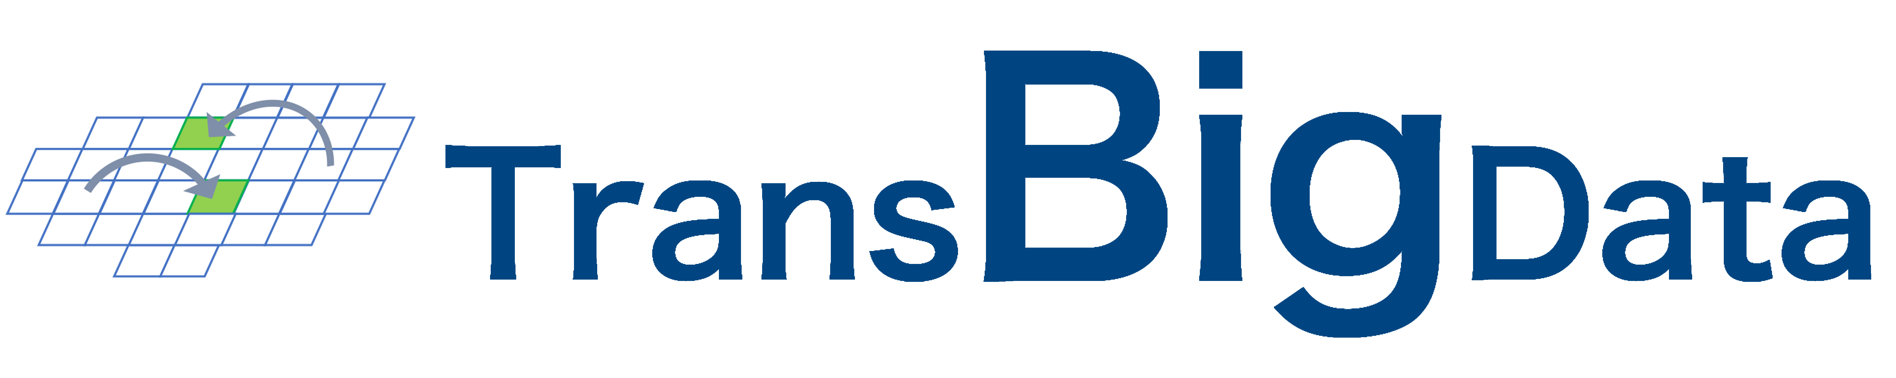
A Python Package for Transportation Spatiotemporal Big Data Processing, Analysis, and Visualization
Jian Yuan, Qing Yu
2022/3/12

Slide 2
TransBigData
Introduction
Background
TransBigData is a Python package developed for transportation spatiotemporal data processing, analysis, and visualization
Target data includes vehicle GPS trajectories, bike sharing data, IC card data
Features
Provide comprehensive methods for each stage of spatiotemporal data analysis
Data Quality
Data Preprocess
Data Gridding
Data Aggregating
Data Visualization
Trajectory Processing
Base-map Loading
Allowing complex processing tasks to be achieved with concise code (e.g., OD matrix extraction)
Potential to implement combinatory analysis with other packages
https://github.com/ni1o1/transbigdata

Slide 3
TransBigData
Why aggregate data to grids?
Discretization
Hard to analyze data in continuous space, but easy to analyze with discretized region
GPS points
Match
Comparable
All grids with same size, attributes are comparable under same standard
Grids
Controllable
Aggregation accuracy is controllable, higher resolution with smaller grids
Aggregate
Efficient
High computation speed for the matching between grids and GPS data.
Data Distribution
TransBigData offer a framework for grid processing

Slide 4
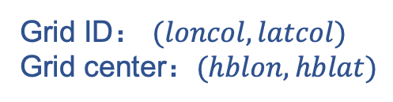
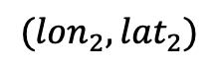



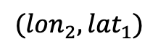
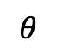
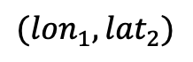
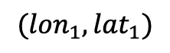
TransBigData
Griding
Griding coordinate system
$$({lon}_{1},{lat}_{2})$$
$$({lon}_{2},{lat}_{2})$$
Grid ID： $(loncol,latcol)$
Grid center：$(hblon,hblat)$
$$∆lon$$
$$∆lat$$
$$θ$$
Optional: Support grids with rotation angle
$$({lon}_{2},{lat}_{1})$$
$$({lon}_{1},{lat}_{1})$$
Griding params: Define a griding coordinate system
params=$({lon}_{1},{lat}_{1}, ∆lon$, $∆lat$, $θ)$

Slide 5
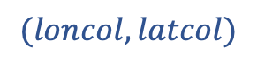
TransBigData
Griding methods offered by TransBigData
GPS points
transbigdata.rect_grids(location, accuracy=500, params='auto’)
Generate the grids in given location: bounds or shape
tbd.GPS_to_grids
transbigdata.grid_params(bounds, accuracy=500)
$$(loncol,latcol)$$
Grid ID
Generate gridding params from bounds
tbd.gridid_to_polygon
transbigdata.GPS_to_grids(lon, lat, params)
study area
Match the GPS data to the grids
tbd.rect_grids
Grid Geometry
transbigdata.grids_centre(loncol, latcol, params)
tbd.grids_centre
Calculate the center location of the grids based on grid ID
transbigdata.gridid_to_polygon(loncol, latcol, params)
Grid center
Generate the grid geometry based on grid ID

Slide 6
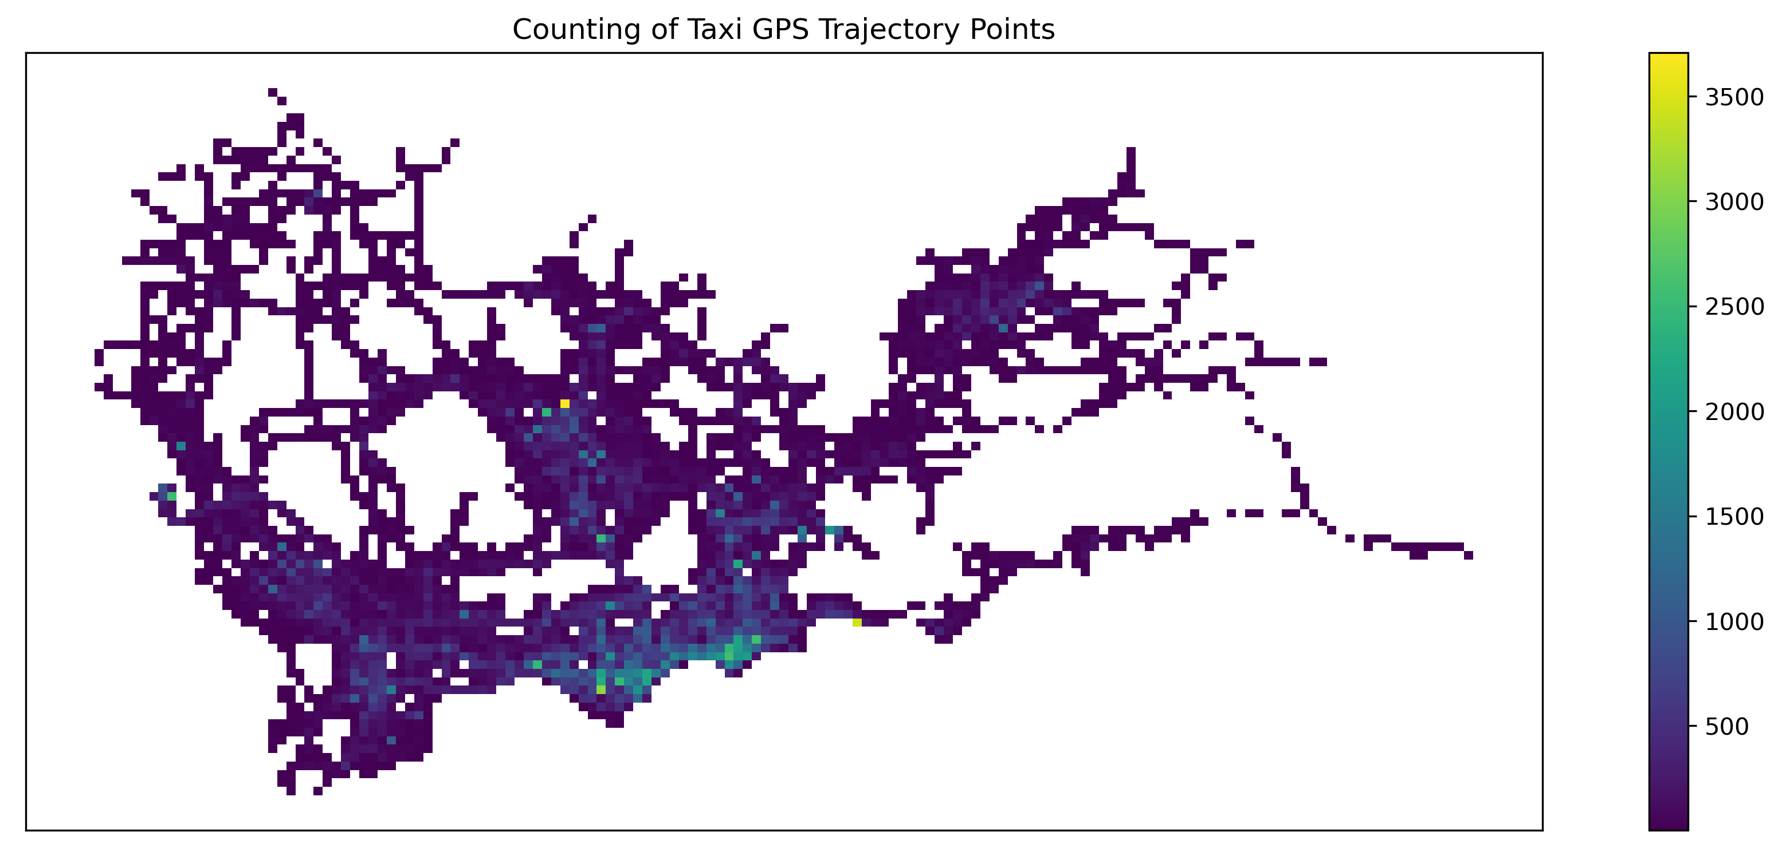
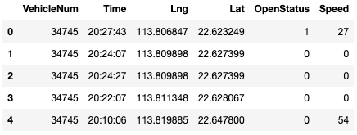
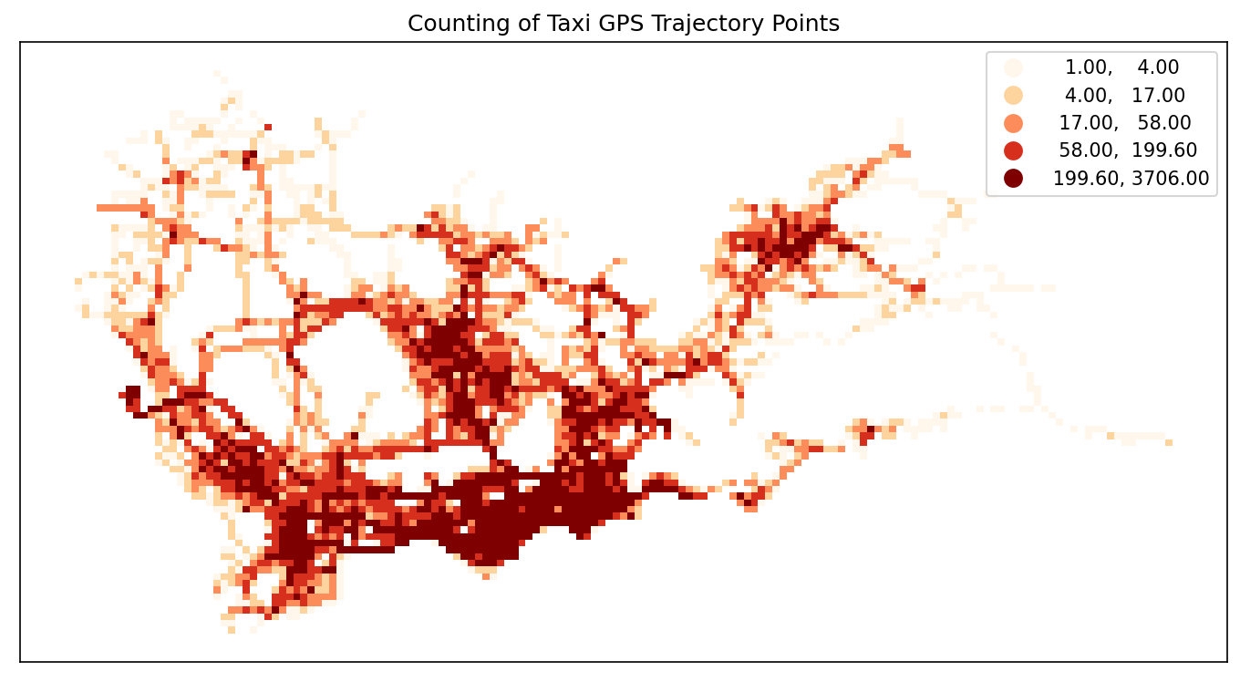
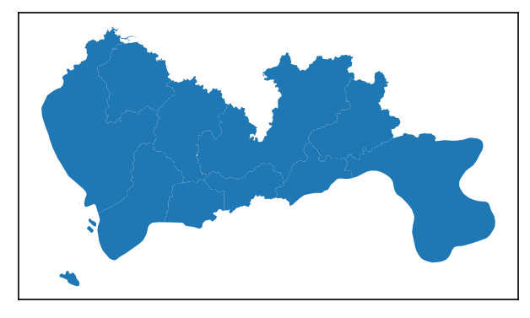
TransBigData
Examples 1: Taxi GPS Data Processing
Data Gridding and Visualization
Taxi GPS Trajectory Data
+
Geometric Data
Counts of Trajectory Points in Each Grid (Could be any)

Slide 7
TransBigData
Examples 1: Taxi GPS Data Processing
Data Gridding and Visualization
Used Methods
剔除界外数据
transbigdata.clean_outofshape(data, shape, col=['Lng', 'Lat'], accuracy=500)
修正载客状态
transbigdata.clean_taxi_status(data, col=['VehicleNum', 'Time', 'OpenStatus'], timelimit=None)
生成栅格参数
tbd.grid_params(bounds, accuracy=500)
+
轨迹匹配栅格
transbigdata.GPS_to_grids(lon, lat, params)
栅格地理信息
transbigdata.gridid_to_polygon(loncol, latcol, params)

Slide 8
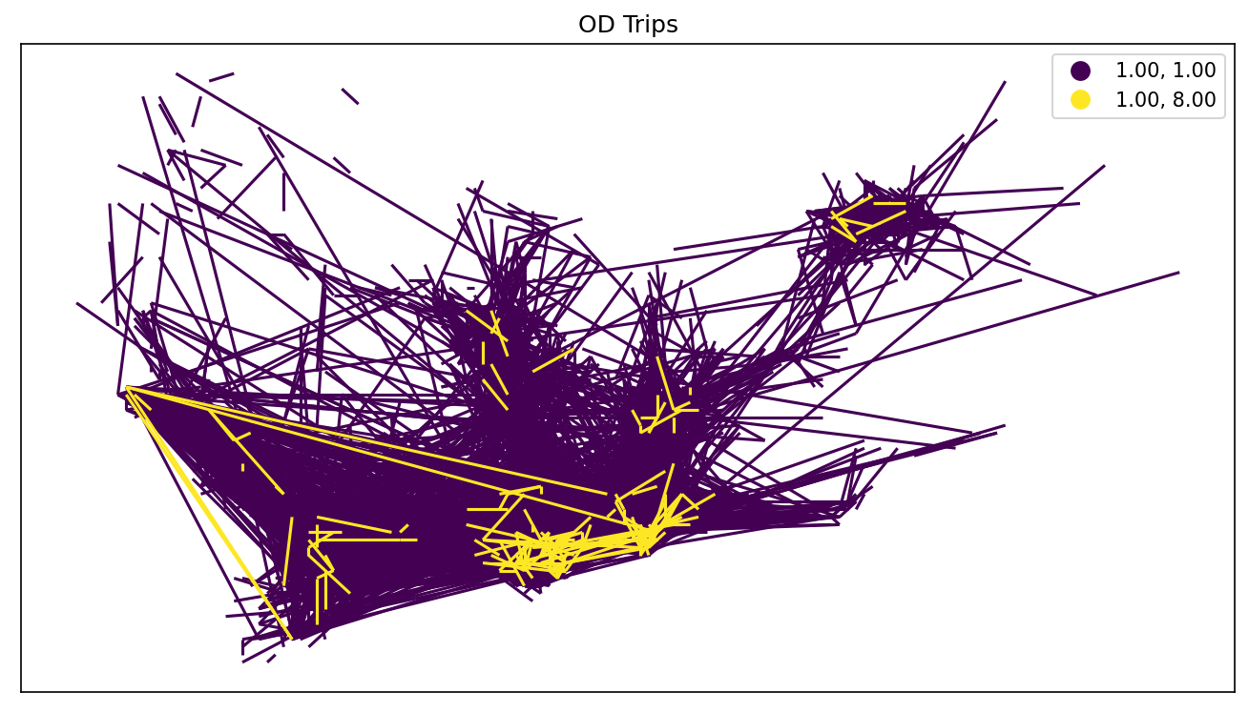
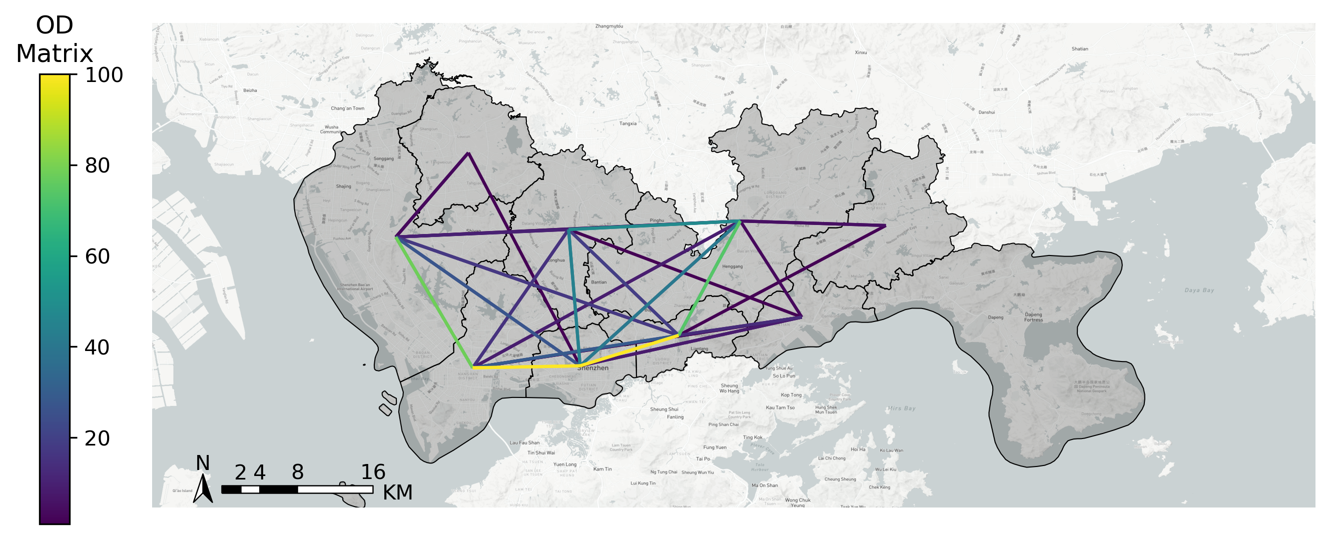
TransBigData
Examples 1: Taxi GPS Data Processing
Individual Trip Extraction, OD Flow Aggregation, Base-map Loading
Grid-Level OD Flow
+
Geometric Data
(Traffic Zone Division)
Traffic-zone-level OD Flow, Base-map Loading

Slide 9


TransBigData
Examples 1: Taxi GPS Data Processing
OD Extraction, OD Aggregation, Base-map Loading, Visualization
Used Methods
OD Extraction
提取个体OD
transbigdata.taxigps_to_od(data, col=['VehicleNum', 'Stime', 'Lng', 'Lat', 'OpenStatus'])
栅格集计获取栅格OD
transbigdata.odagg_grid(oddata, params, col=['slon', 'slat', 'elon', 'elat'], arrow=False)
+
区域集计获取区域OD
transbigdata.odagg_shape(oddata, shape, col=['slon', 'slat', 'elon', 'elat'], params=None, round_accuracy=6, arrow=False)
Visualization
地图底图加载
transbigdata.plot_map(plt, bounds, zoom='auto', style=4, printlog=False, styleid='dark')
Others
载客空驶点位
transbigdata.taxigps_traj_point(data, oddata, col=['Vehicleid', 'Time', 'Lng', 'Lat', 'OpenStatus'])

Slide 10
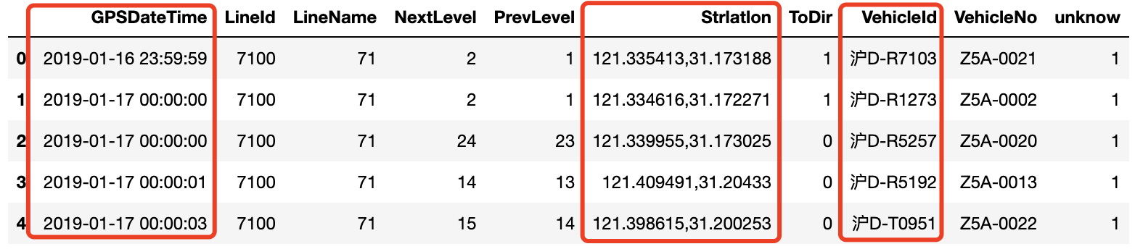
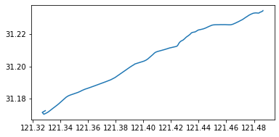
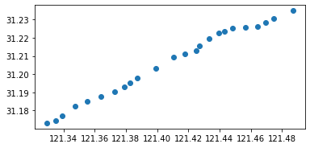
TransBigData
Examples 2: Bus GPS Data Processing
Identification of Bus Arrival/Departure Time
when
where
who
Column Information of Bus Trajectory Data
Geometric Data of the Bus Line
Geometric Data of the Bus Station (One-way)

Slide 11
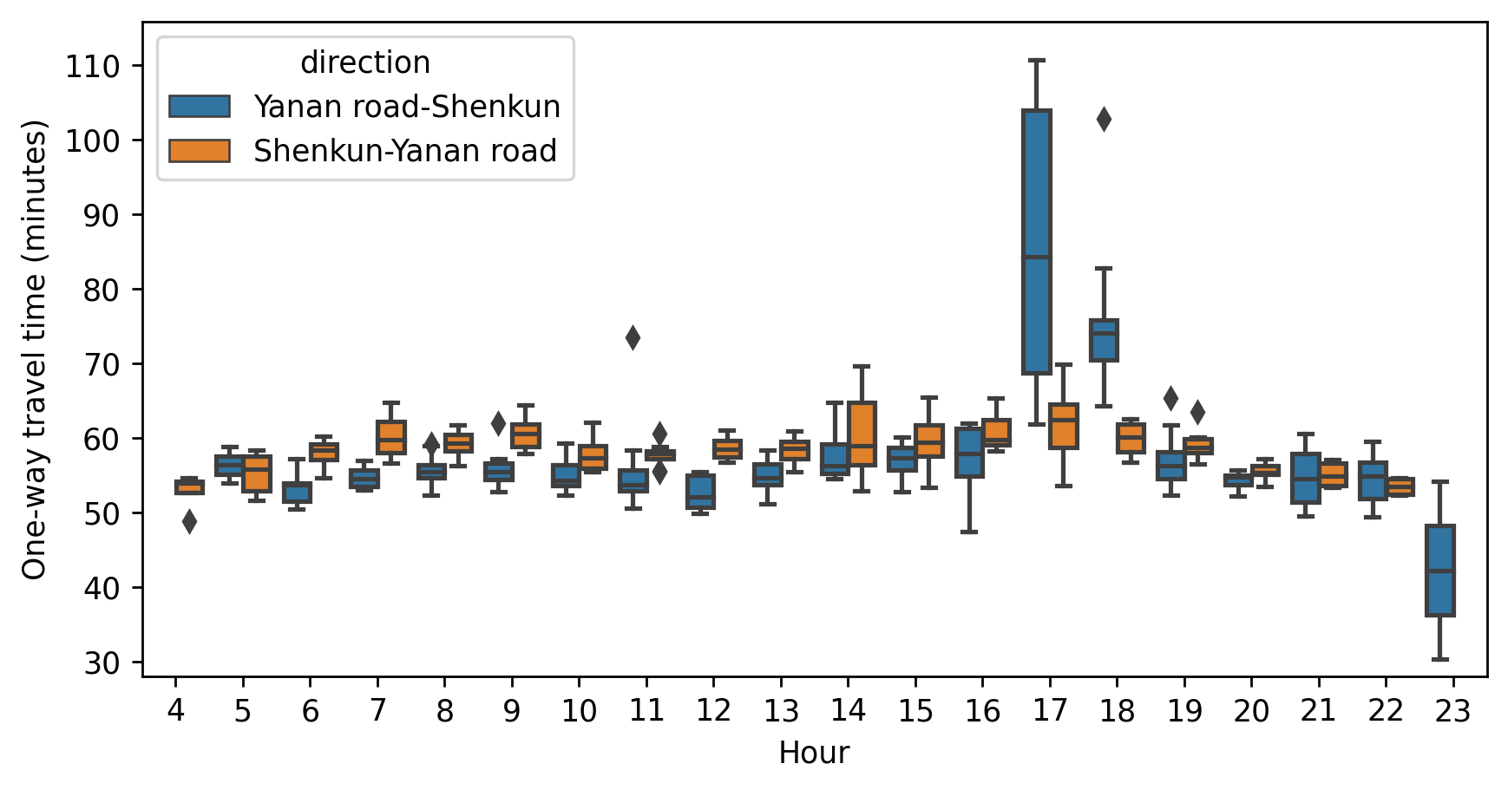
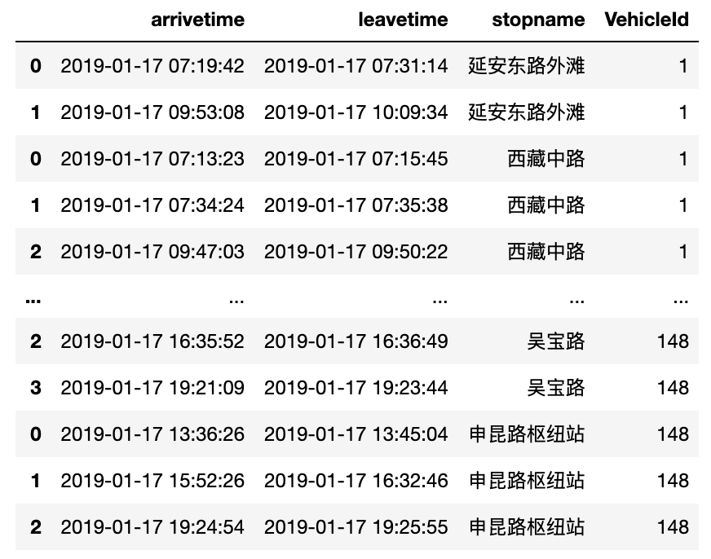
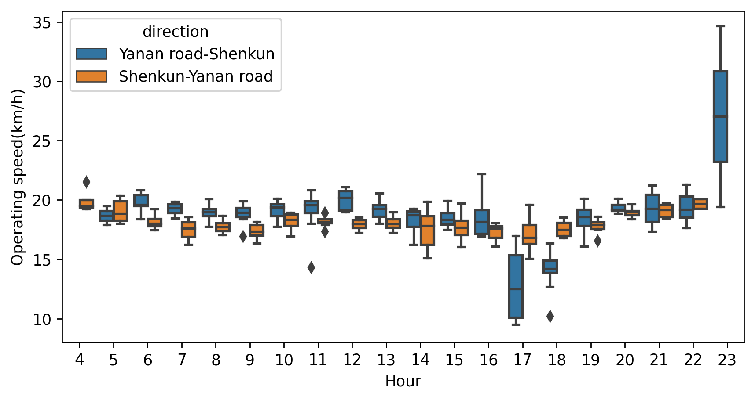
TransBigData
Examples 2: Bus GPS Data Processing
Identification of Bus Arrival/Departure Time
提取车辆到离站时刻
transbigdata.busgps_onewaytime(arrive_info, start, end, col=['VehicleId', 'stopname', 'arrivetime', 'leavetime'])
One-Way Travel Time
Operation Speed

Slide 12
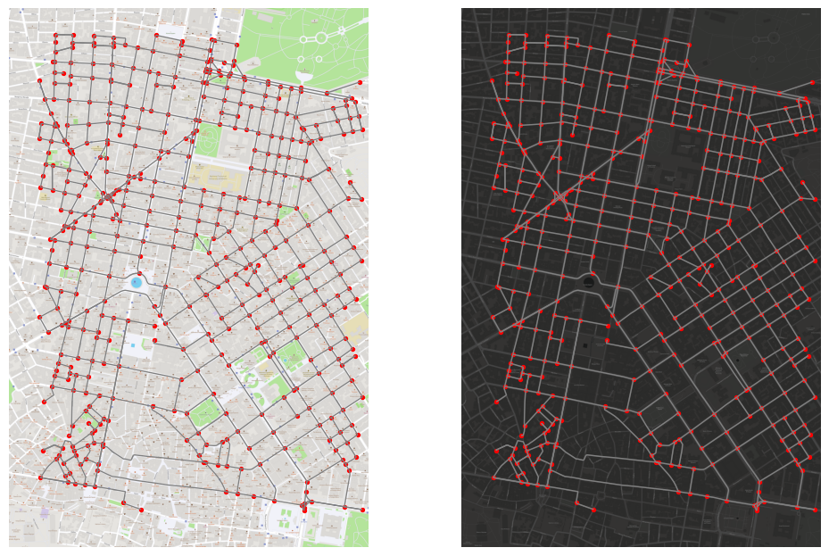
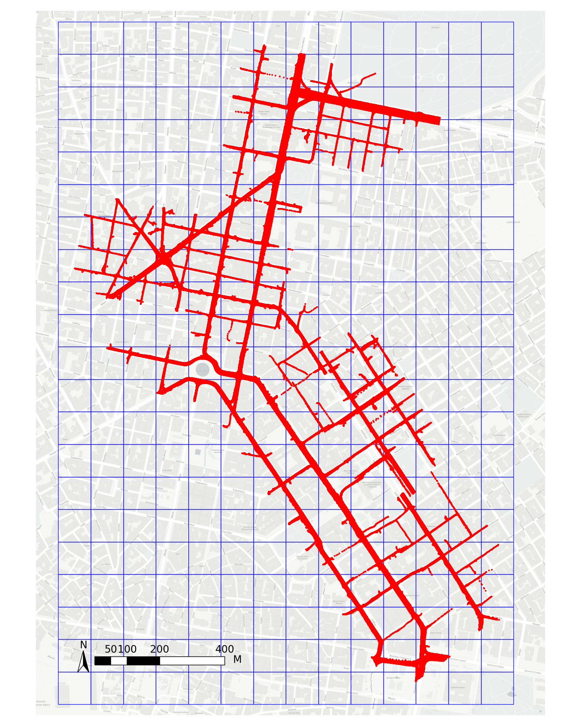
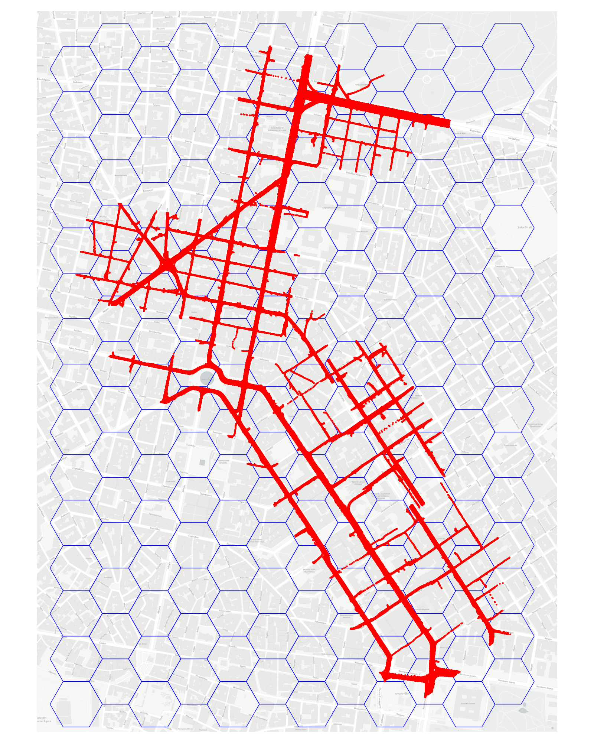
TransBigData
Examples 3: OD/Route Flow Extraction based on the pNEUMA Dataset
Data Preparation
Base-map Loading (Different Visualization Styles)
Data Gridding (Rectangular/Hexagon Approach)
(Network topology: from OSMNX)
pNEUMA: https://open-traffic.epfl.ch/
Notes:
方形栅格渔网: transbigdata.rect_grids(location, accuracy=500, params='auto')
正六边形栅格渔网：transbigdata.hexagon_grids(bounds, accuracy=500)

Slide 13
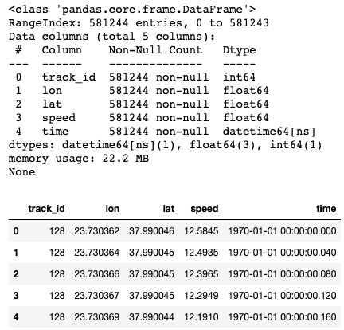
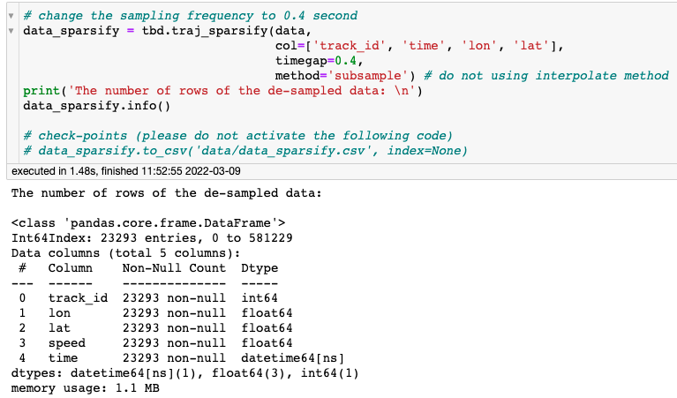
TransBigData
Examples 3: OD/Route Flow Extraction based on the pNEUMA Dataset
Data Compression (1/2)
采样频率调整
transbigdata.traj_sparsify(data, col=['Vehicleid', 'Time', 'Lng', 'Lat'], timegap=15)
The Origin Sampling Frequency is 0.04 sec
Set the Sampling Frequency to 0.4 sec
Notes:
方形栅格渔网: transbigdata.rect_grids(location, accuracy=500, params='auto')
正六边形栅格渔网：transbigdata.hexagon_grids(bounds, accuracy=500)

Slide 14
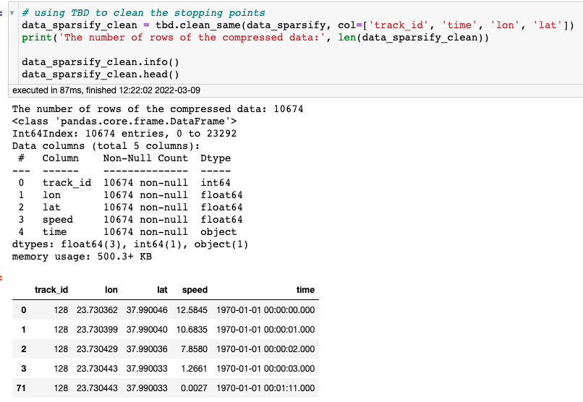
TransBigData
Examples 3: OD/Route Flow Extraction based on the pNEUMA Dataset
Data Compression (2/2)
去除中间不动点
transbigdata.clean_same(data, col=['VehicleNum', 'Time', 'Lng', 'Lat'])
Before
After
Notes:
方形栅格渔网: transbigdata.rect_grids(location, accuracy=500, params='auto')
正六边形栅格渔网：transbigdata.hexagon_grids(bounds, accuracy=500)

Slide 15
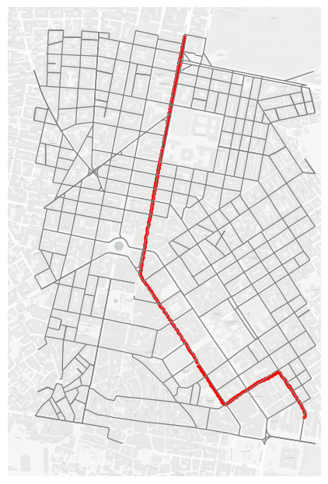
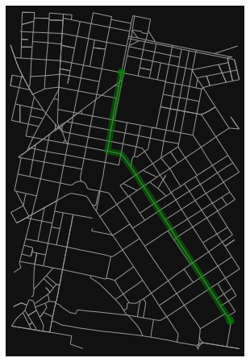
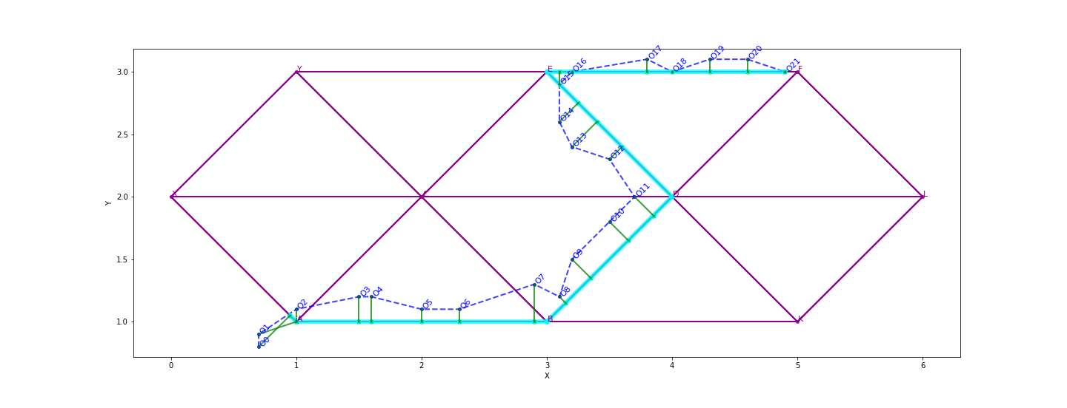
TransBigData
Examples 3: OD/Route Flow Extraction based on the pNEUMA Dataset
Analysis of Route Choice Behavior (Combined with map-matching and shortest path searching
Map-matching
using leuvenmapmatching
An Individual Trip
The Shortest Path
Notes:
方形栅格渔网: transbigdata.rect_grids(location, accuracy=500, params='auto')
正六边形栅格渔网：transbigdata.hexagon_grids(bounds, accuracy=500)

Slide 16
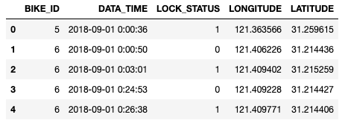

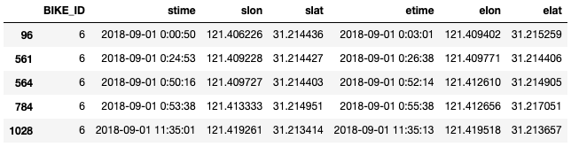
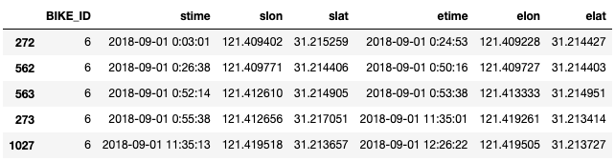
TransBigData
Examples 4: Community Detection Based on the Bike Sharing Data
Data
The Origin Form of the Bike Sharing Data
(Only generate records when “LOCK_STATUS” changes)
Geometric Data
骑行/静止信息
transbigdata.bikedata_to_od(data, col=['BIKE_ID', 'DATA_TIME', 'LONGITUDE', 'LATITUDE', 'LOCK_STATUS'], startend=None)
Moving Trips (for OD extraction and community detection)
Locked Records (for operation analysis and optimization)

Slide 17
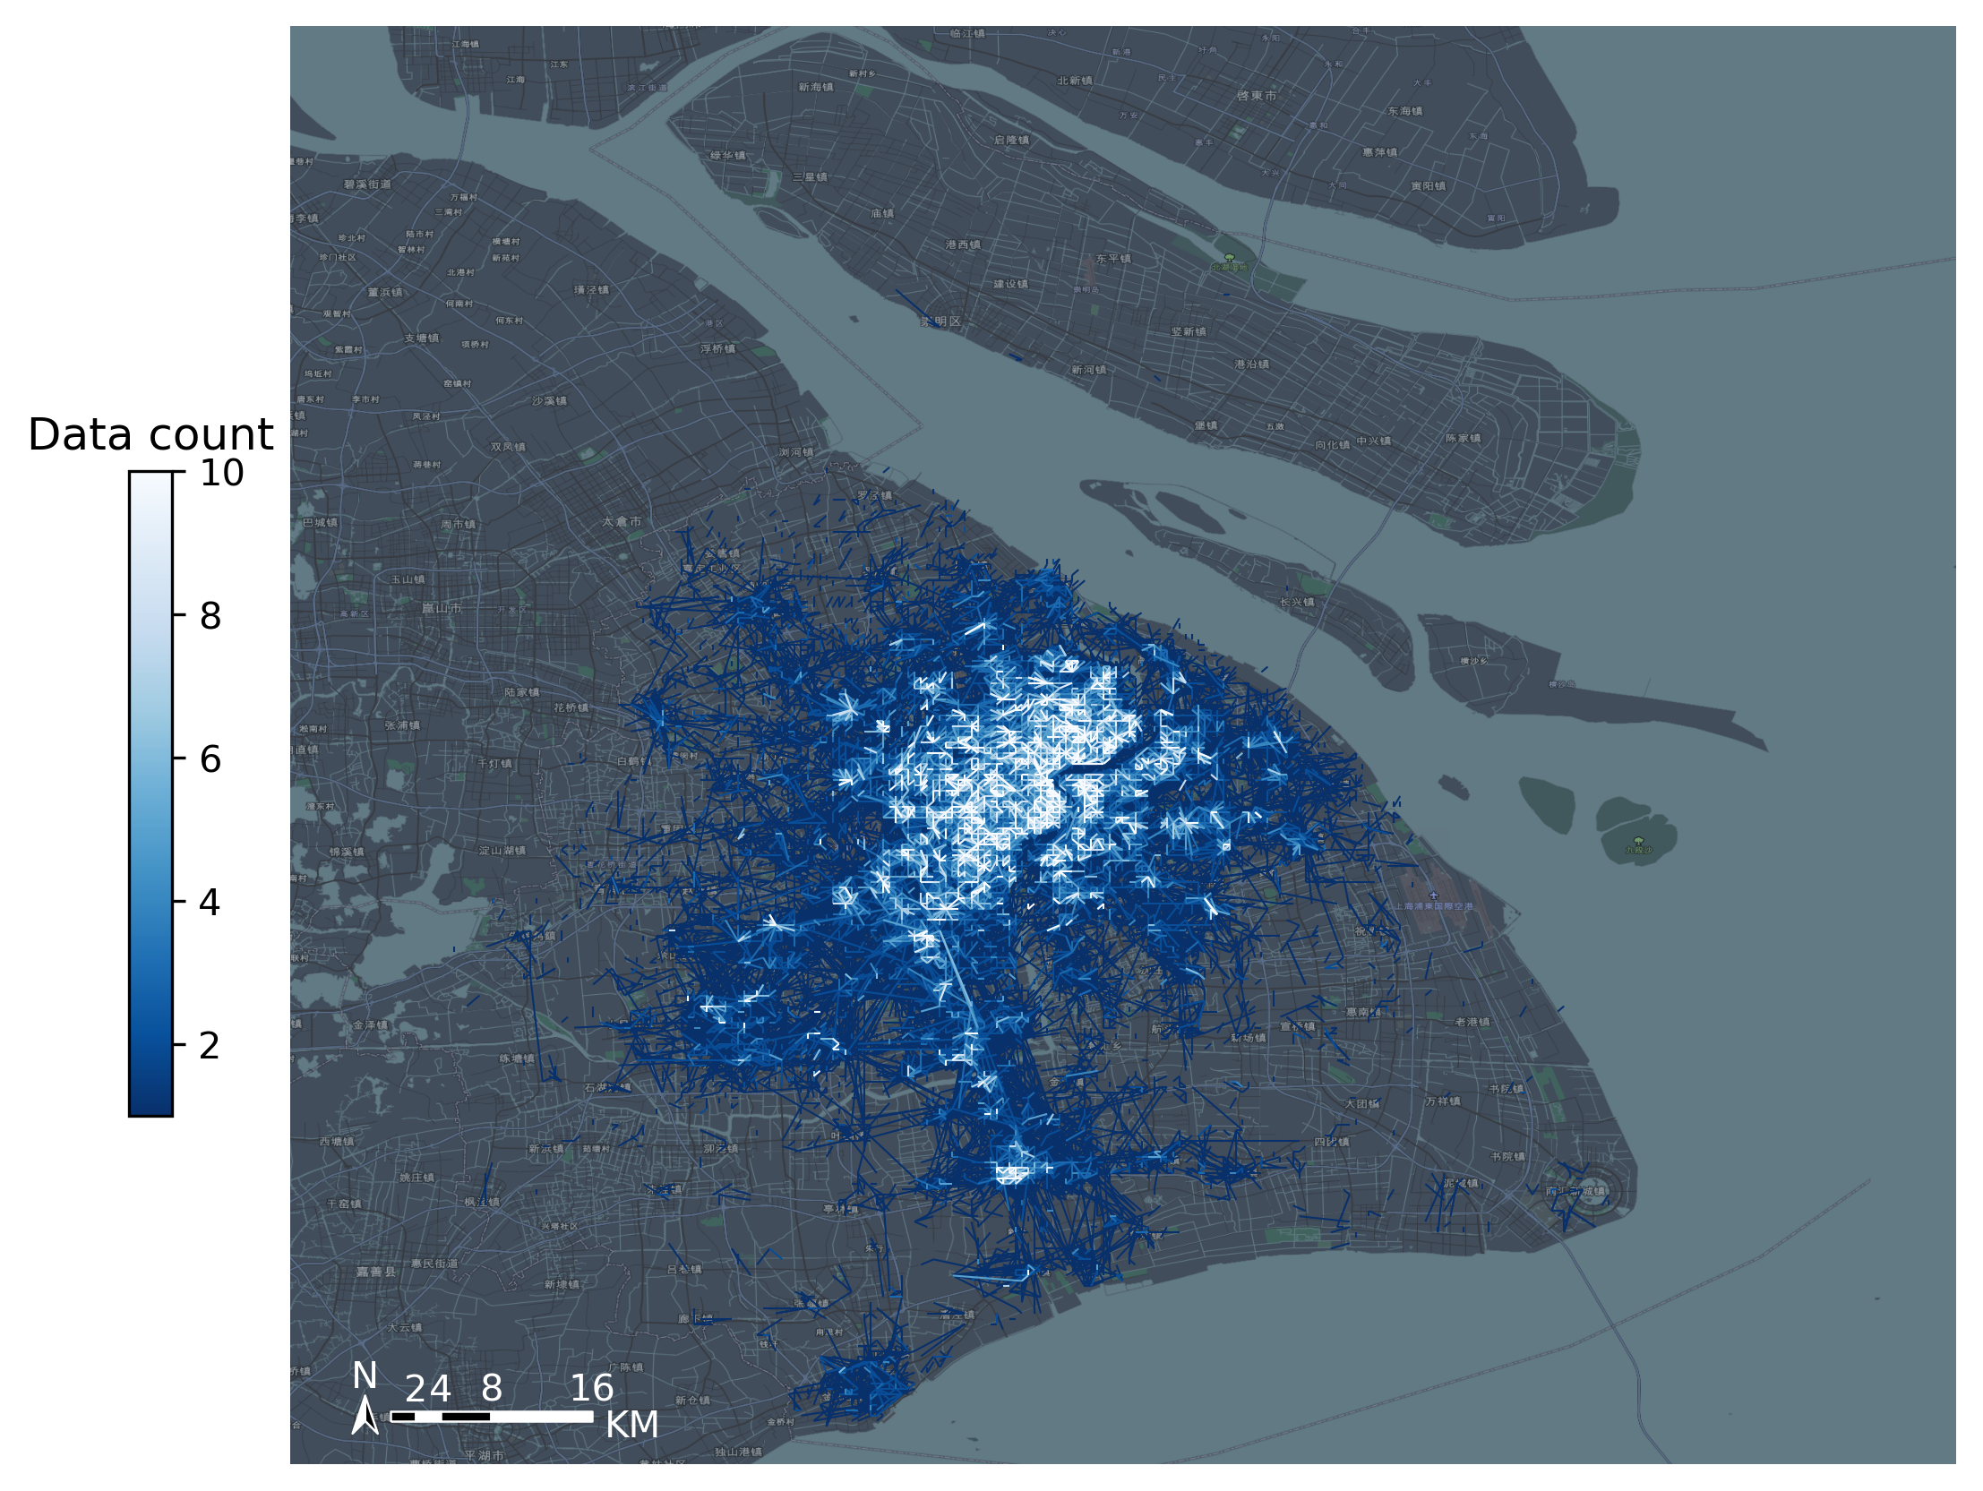
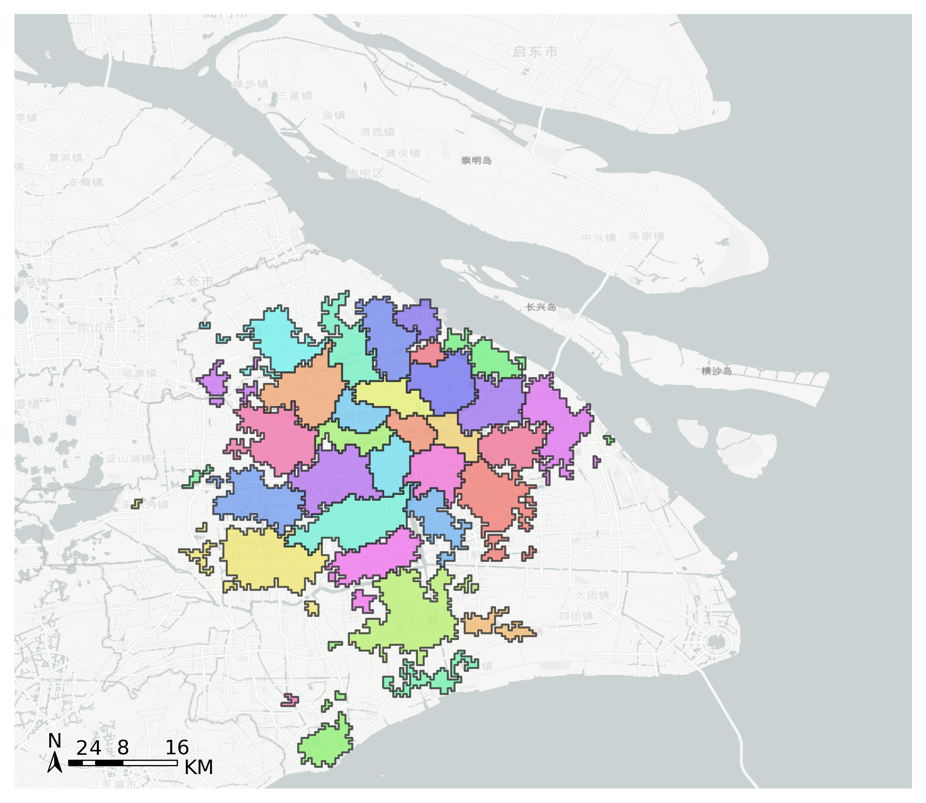
TransBigData
Examples 4: Community Detection Based on the Bike Sharing Data
OD Extraction
Community Detection (combined with iGraph)
https://github.com/ni1o1/transbigdata/tree/main/example

Slide 18

TransBigData
Examples 4: Community Detection Based on the Bike Sharing Data
Used Methods
OD Extraction
生成栅格数据
tbd.grid_params(bounds, accuracy=500)
栅格集计获取栅格OD
transbigdata.odagg_grid(oddata, params, col=['slon', 'slat', 'elon', 'elat'], arrow=False)
+
Visualization
地图底图加载
transbigdata.plot_map(plt, bounds, zoom='auto', style=4, printlog=False, styleid='dark')
指北针比例尺
transbigdata.plotscale(ax, bounds, textcolor='k', textsize=8, compasssize=1, accuracy='auto', rect=[0.1, 0.1], unit='KM', style=1, **kwargs)
Others
计算相对距离
transbigdata.getdistance(lon1, lat1, lon2, lat2)

Slide 19
谢谢，请赐教！
Jian Yuan, Qing Yu
2022/3/12

